Slide 1
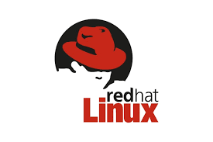

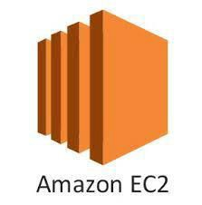
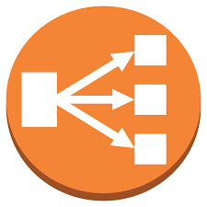

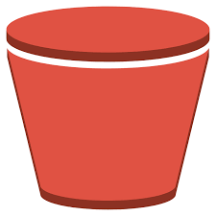
DEVOPS COURSE CONTENT
INTRODUCTION OF CLOUD COMPUTING
What is Cloud?
Evolution of Cloud Computing
IAAS (Infrastructure as a Service)
SAAS (Software as a Service)
PAAS (Platform as a Service)
Private, Public and Hybrid Cloud
LINUX
Linux OS Introduction
Importance of Linux in DevOps
Linux Basic Command Utilities
Linux Administration
Linux commands
AWS CORE SERVICES
EC2 Instances
S3 Buckets
Load Balancers & Route 53
IAM policies
VPC

Slide 2
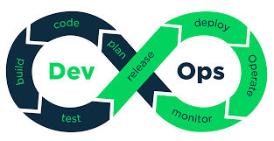


INTRODCUTION OF DEVOPS
What Is Devops
History of Devops
Devops definition
DevOps Main Objectives
DevOps and Software Development Life C
Waterfall Model
Agile Model
Introduction to Devops tools
ycle
VERSION CONTROL SYSTEM(vcs)- Git and Bit bucket
What is Version control system
Brief about Git and Bit bucket
Differences between GIT and Bit bucket
Installation of Git
GIT Features
3-Tree Architecture
`GIT – Clone /Commit / Push
GIT Hub Projects
GIT Hub Management
GIT Rebase & Merge
GIT Stash, Reset, Checkout
GIT Clone, Fetch, Pull.

Slide 3
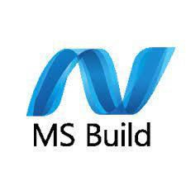

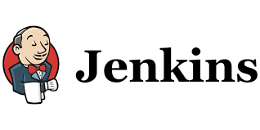
Build tool- Maven
Introduction of build tool
Maven Installation
Maven Build requirements
Maven POM Builds (pom.xml)
Maven Build Life Cycle
Maven Local Repository (.m2)
Maven Global Repository
Group ID, Artifact ID, Snapshot
Maven Dependencies
Maven Plugins
Artifacts concepts (WAR, JAR and Docker Image)
Continuous Integration – Jenkins
Introduction to Jenkins
Jenkins Installation
Jenkins Plugins
Continuous Integration with Jenkins
Configure Jenkins
Jenkins Management

Slide 4
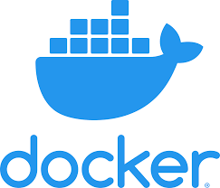
Scheduling build Jobs
POLL SCM
Build Periodically
Maven Build Scripts
Support for the GIT version control System
Different types of Jenkins Jobs
Jenkins Build Pipe Line
Sequential Builds
Jenkins Master & Slave Node Configuration
Jenkins Workspace Management
Creating Users
SCM plugin
Build and test
Docker
What is Container
How to get Docker Image?
What is Docker Image
Docker Installation
Working with Docker Containers
Docker Engine
Working with Images
Docker Compose

Slide 5
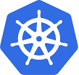
Docker Hub
Docker File and Docker compose file
Docker Commands
Kubernetes
Introduction of Kubernetes
Kubernetes Architecture
Components of Kubernetes
Kubernetes commands at a glance
Kubernetes configuration files
Kubernetes Volumes

